Slide 1
Sensors & Classification

Slide 2
Overview
What are Sensors?
Detectable Phenomenon
Physical Principles – How Do Sensors Work?
Need for Sensors
Choosing a Sensor
Sensor Descriptions
  Temperature Sensor
  Accelerometer
  Light Sensor
  Magnetic Field Sensor
  Ultrasonic Sensor
  Photogate
  CO₂ Gas Sensor

Slide 3
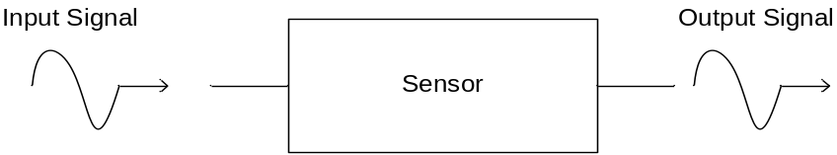
What are Sensors?
American National Standards Institute (ANSI) Definition
  A device which provides a usable output in response to a specified measurand
A sensor acquires a physical parameter and converts it into a signal suitable for processing (e.g. optical, electrical, mechanical)
A transducer
  Microphone, Loud Speaker, Biological Senses (e.g. touch, sight,…ect)

Slide 4
Detectable Phenomenon
Stimulus | Quantity
Acoustic | Wave (amplitude, phase, polarization), Spectrum, Wave Velocity
Biological & Chemical | Fluid Concentrations (Gas or Liquid)
Electric | Charge, Voltage, Current, Electric Field (amplitude, phase, polarization), Conductivity, Permittivity
Magnetic | Magnetic Field (amplitude, phase, polarization), Flux, Permeability
Optical | Refractive Index, Reflectivity, Absorption
Thermal | Temperature, Flux, Specific Heat, Thermal Conductivity
Mechanical | Position, Velocity, Acceleration, Force, Strain, Stress, Pressure, Torque

Slide 5
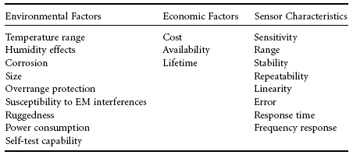
Choosing a Sensor

Slide 6
Characteristics of different types of sensors
Active vs. Passive
Digital vs. Analog
Null and deflection methods
Input – Output configuration

Slide 7
Active vs. Passive
Sensors
• 1) Active sensors: Require an external source of power (excitation voltage) that provides the majority of the output power of the signal
• 2) Passive sensors: The output power is almost entirely provided by the measured signal without an excitation voltage

Slide 8
Digital vs. Analog Sensors
Digital sensors: The signal produced or reflected by the sensor is binary
Analog sensors: The signal produced by the sensor is continuous and proportional to the measurand

Slide 9
Null and Deflection Methods
Deflection: The signal produces some physical (deflection) effect closely related to the measured quantity and transduced to be observable.
Null: The signal produced by the sensor is counteracted to minimize the deflection. That opposing effect necessary to maintain a zero deflection should be proportional to the signal of the measurand

Slide 10
Input-Output Configuration
1) Method of inherent insensitivity: Use whenever possible
2) Method of high gain feedback:
3) Method of calculated output corrections
4) Method of signal filtering
5) Method of opposing inputs

Slide 11
Temperature Sensor
Temperature sensors appear in building, chemical process plants, engines, appliances, computers, and many other devices that require temperature monitoring
Many physical phenomena depend on temperature, so we can often measure temperature indirectly by measuring pressure, volume, electrical resistance, and strain

Slide 12
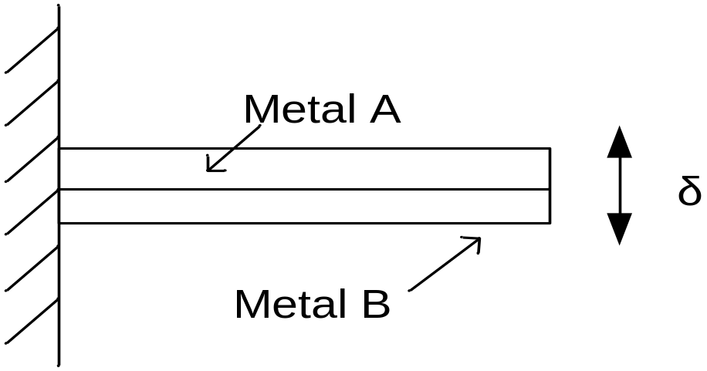

Temperature Sensor
Bimetallic Strip
Application
  Thermostat (makes or breaks electrical connection with deflection)

Slide 13
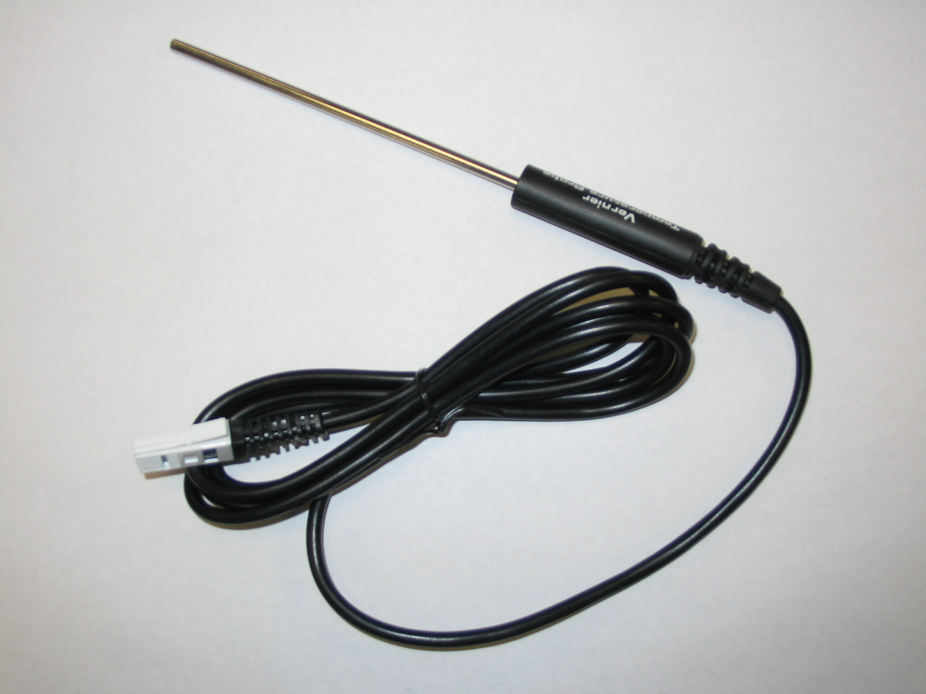
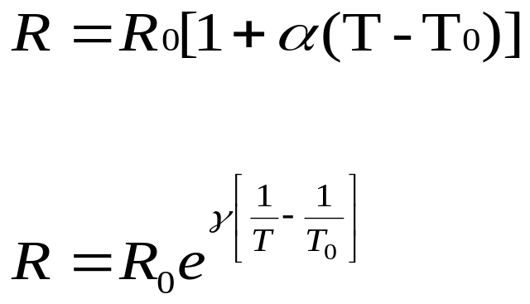
Temperature Sensor
Resistance temperature device.

Slide 14
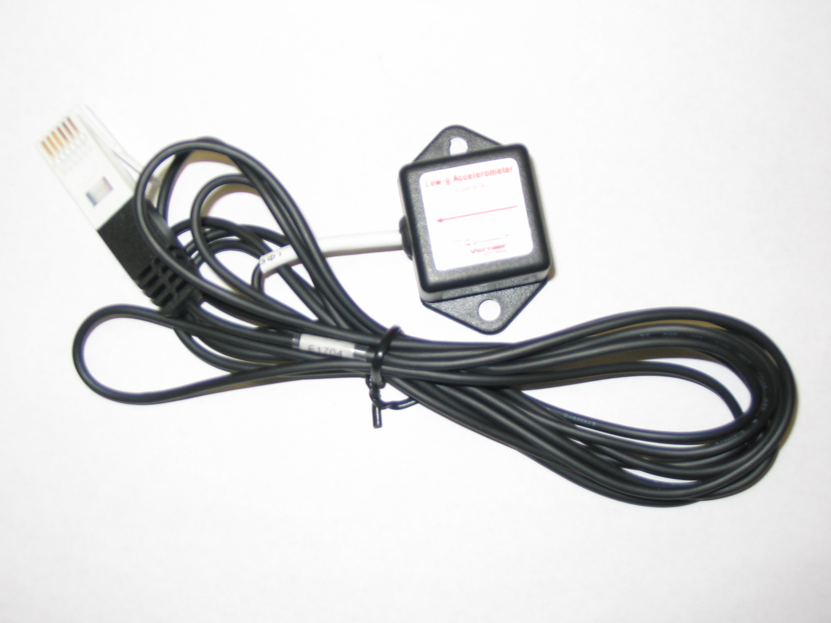
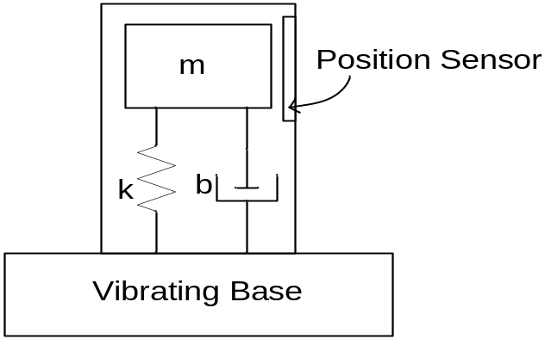
Accelerometer
Accelerometers are used to measure along one axis and is insensitive to orthogonal directions
Applications
  Vibrations, blasts, impacts, shock waves
  Air bags, washing machines, heart monitors, car alarms
Mathematical Description is beyond the scope of this presentation. See me during lunch if interested

Slide 15
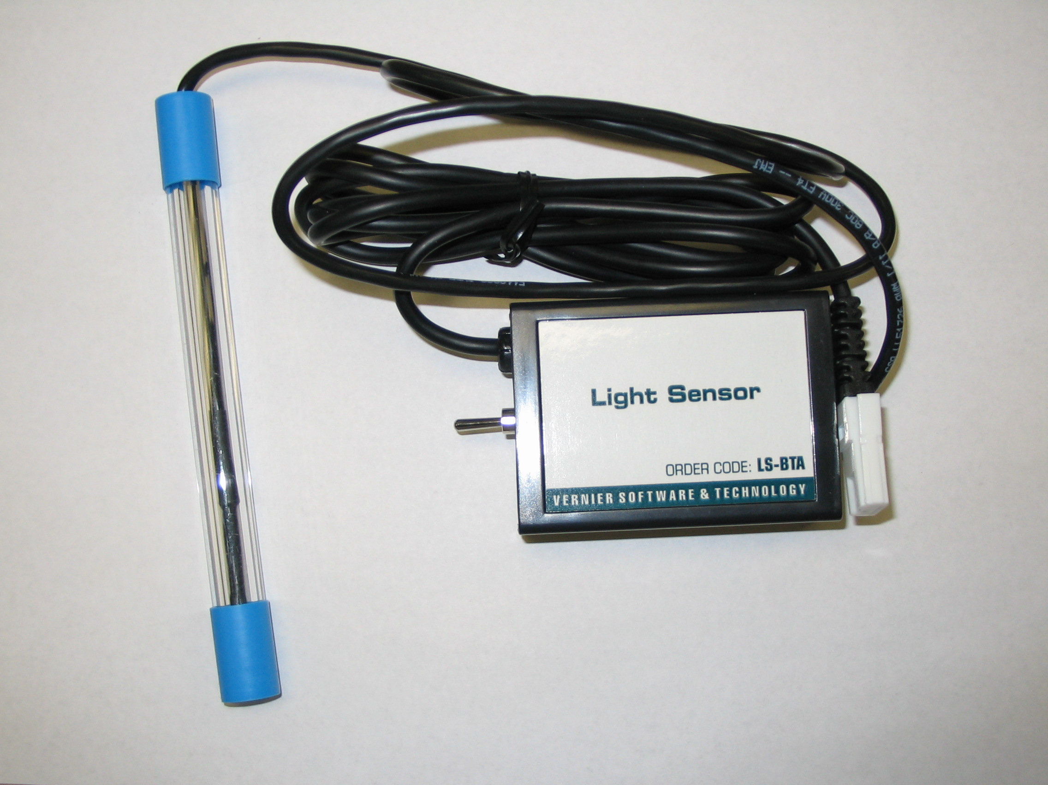
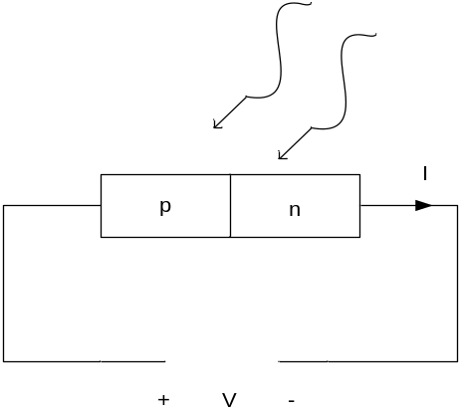
Light Sensor
Light sensors are used in cameras, infrared detectors, and ambient lighting applications
Sensor is composed of photoconductor such as a photoresistor, photodiode, or phototransistor

Slide 16
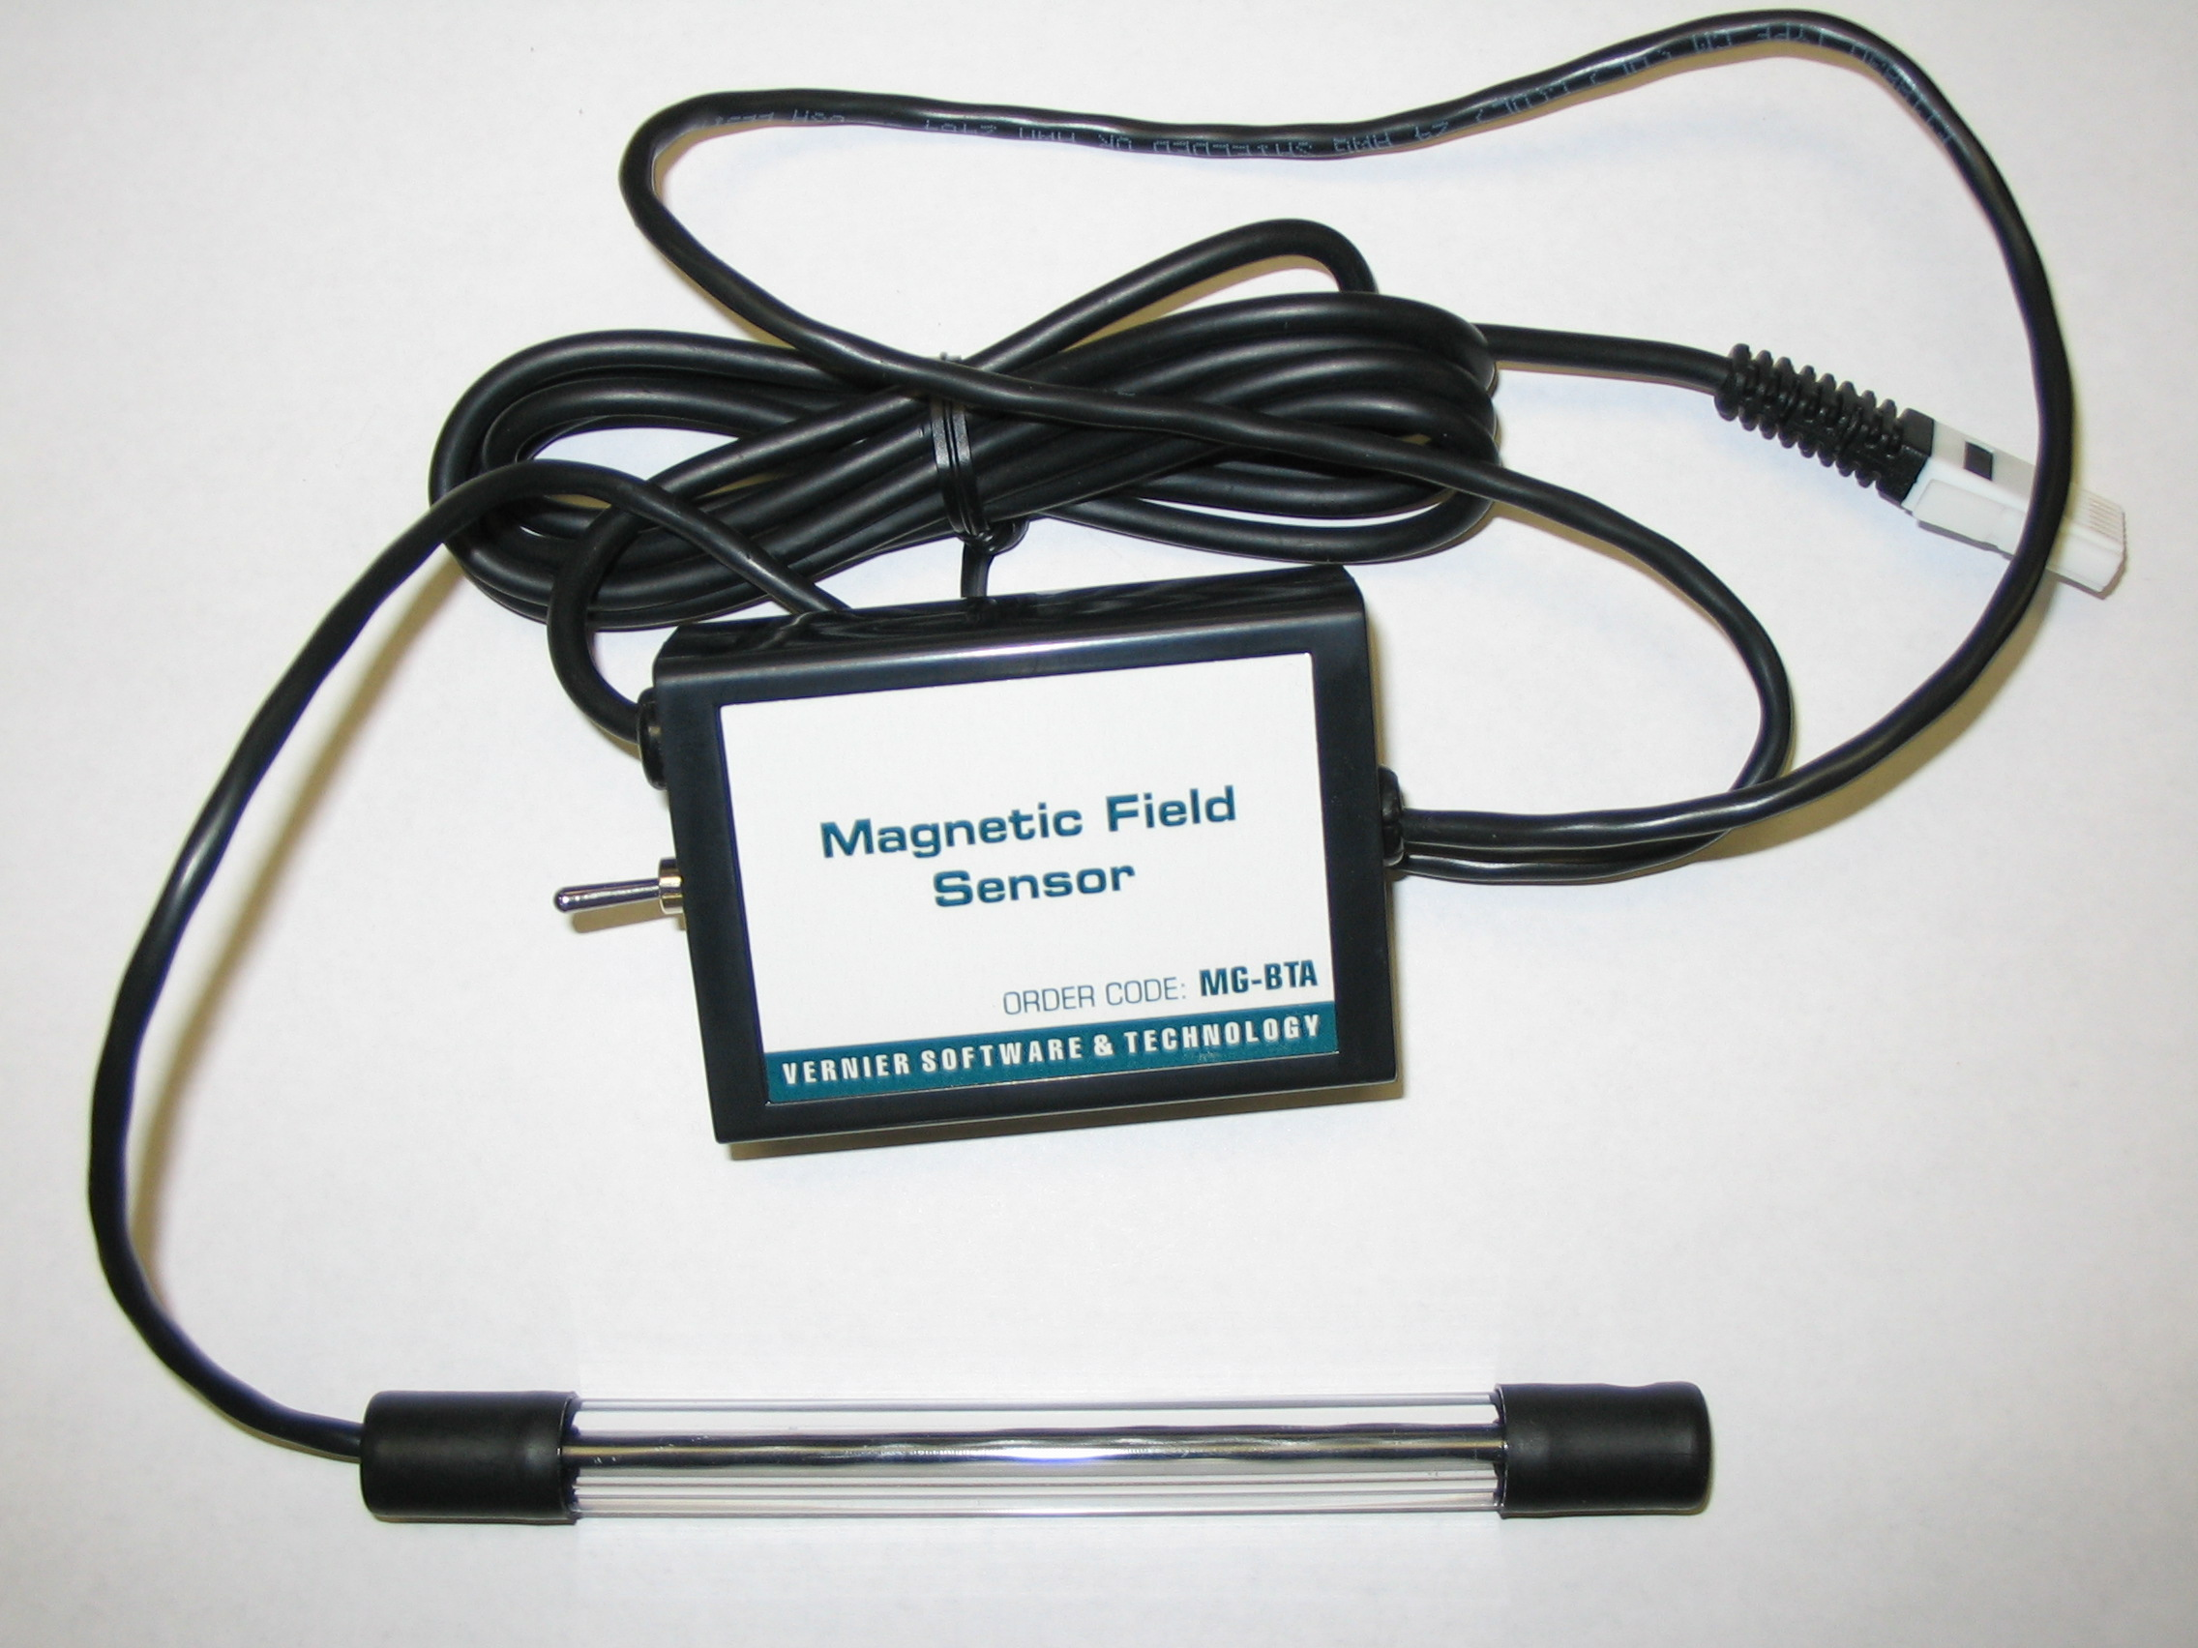
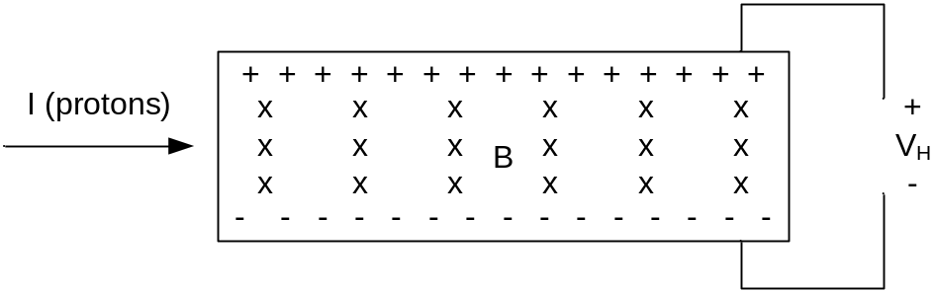
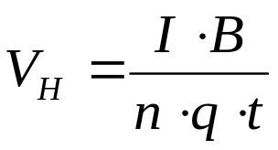
Magnetic Field Sensor
Magnetic Field sensors are used for power steering, security, and current measurements on transmission lines
Hall voltage is proportional to magnetic field

Slide 17
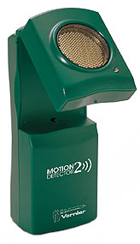
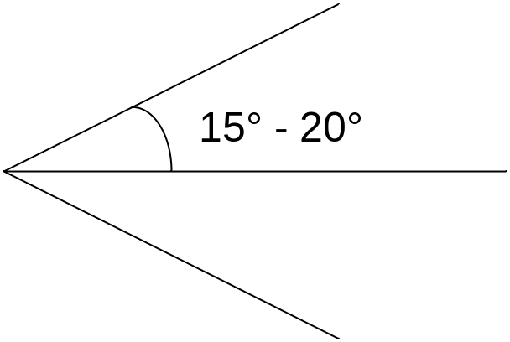
Ultrasonic Sensor
Ultrasonic sensors are used for position measurements
Sound waves emitted are in the range of 2-13 MHz
Sound Navigation And Ranging (SONAR)
Radio Dection And Ranging (RADAR) – ELECTROMAGNETIC WAVES !!

Slide 18
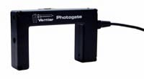
Photogate
Photogates are used in counting applications (e.g. finding period of period motion)
Infrared transmitter and receiver at opposite ends of the sensor
Time at which light is broken is recorded

Slide 19

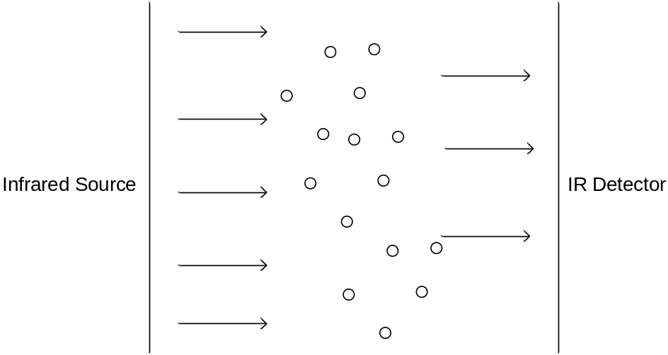
CO₂ Gas Sensor
CO₂ sensor measures gaseous CO₂ levels in an environment
Measures CO₂ levels in the range of 0-5000 ppm
Monitors how much infrared radiation is absorbed by CO₂ molecules

Slide 20
Thank you for all your cooperation during the whole course

